Slide 1
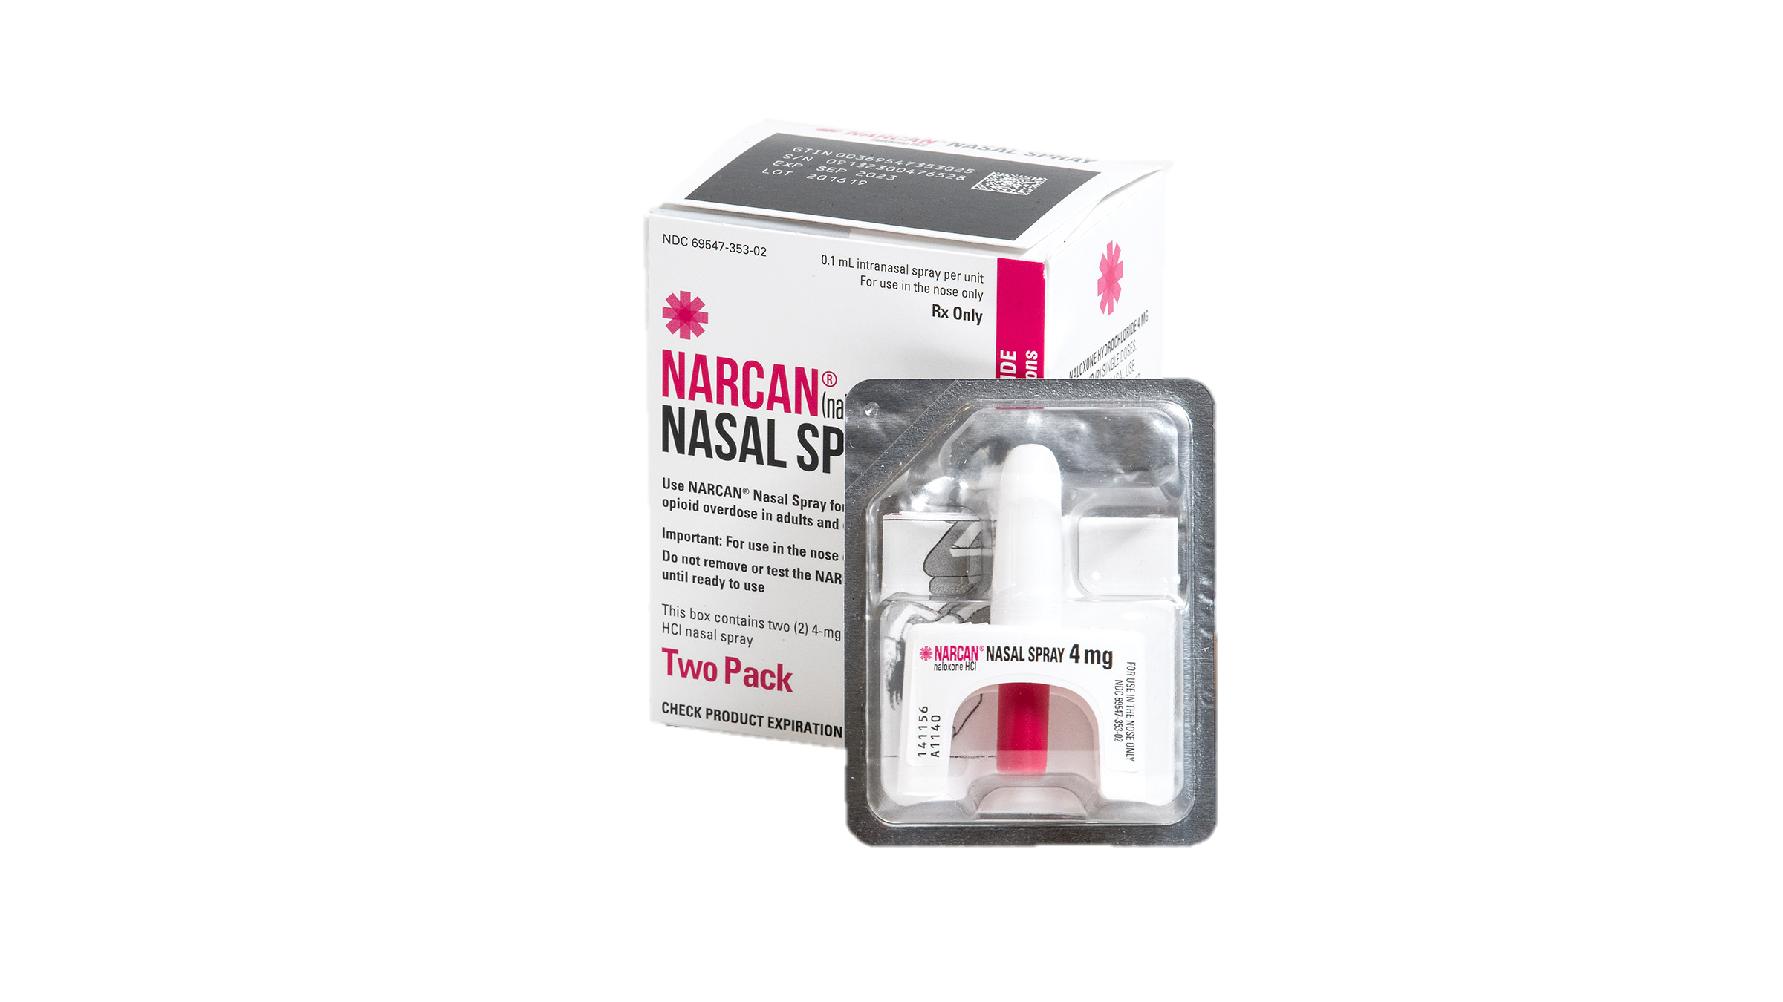
SUH Narcan Presentation
Courtney Morgan- AmeriCorps Member,
Overdose Prevention Champion
Healthy Communities
Created by: Briana Reaves, MBA
CHCI SUH Program Manager
Center for Key Populations: Reimagining Primary Care

Slide 2
Objectives
What is an Opioid?
Learn and Identify signs and symptoms of opioid drug overdose
Develop the skills to administer Narcan
Review the use of Narcan Protocol in responding to an opioid overdose
The Good Samaritan law
Terms to use and avoid with addiction
Center for Key Populations: Reimagining Primary Care

Slide 3
What is an Opioid?
Heroin
Hydrocodone
Oxycodone
Percocet
Vicodin
Morphine
Tramadol
Fentanyl
Methadone
Notes:
Opioids are a class of drugs that can include prescription drugs like Oxycodone, Percocet, Hyrdocone and the others listed on the slide.
While heroin is highly addictive what is being seen on the street are synthetic opioids such as Heroin laced with fentanyl.
Opioids affect both the spinal cord and the brain as it reduces the intensity of pain-signal perception giving a Euphoria or “high” feeling.
Opioids slow down the actions of the body such as breathing and heartbeat.
Many young people who inject heroin have actually reported misuse of prescription opioids first.

Slide 4
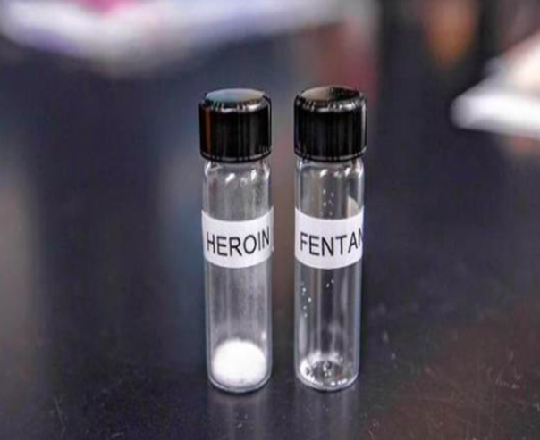
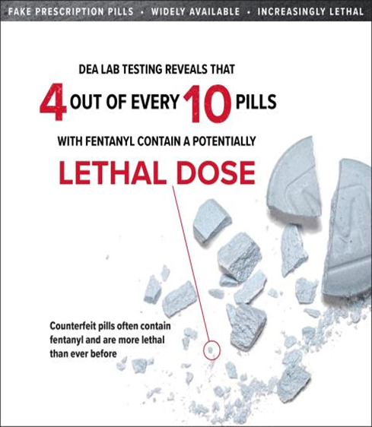
Heroin vs. Fentanyl
Notes:
Fentanyl is 50 times more potent than Heroin. Unlike Heroin it can be prescribed as a pain reliever to treat severe pain following surgery or for chronic pain.
Fentanyl can be absorbed through the skin and be lethal in very small doses as little as 0.25mg as you see in this picture.
Fentanyl is cheaper and more easier to obtain than heroin and is often used in Heroin.

Slide 5
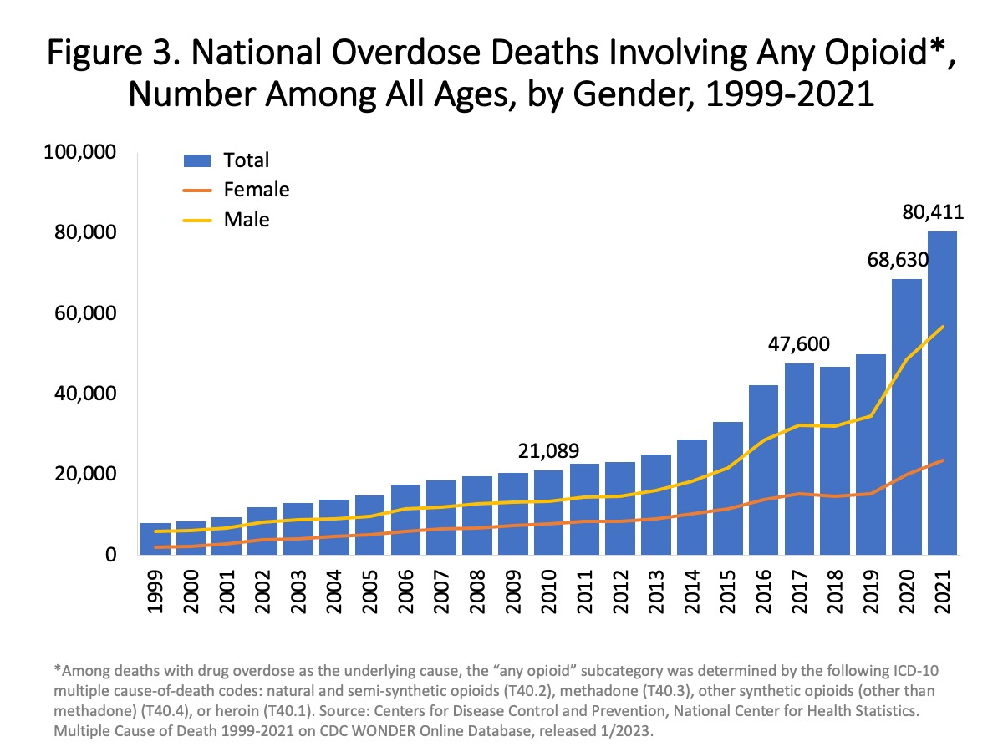
Notes:
This is a bar and line graph showing the total number of U.S. overdose deaths involving any kind of opioid from 1999-2021.
Opioid involved overdose deaths rose from 21,089 in 2010 to 47,600 in 2017 and remained steady through 2019.
Significant increase in 2020 with 68,630 reported deaths and again in 2021 with 80,411 reported deaths. (COVID)
So that was a 12,781 increase just in one year. This is why it is so important for us to know how to administer Narcan.

Slide 6
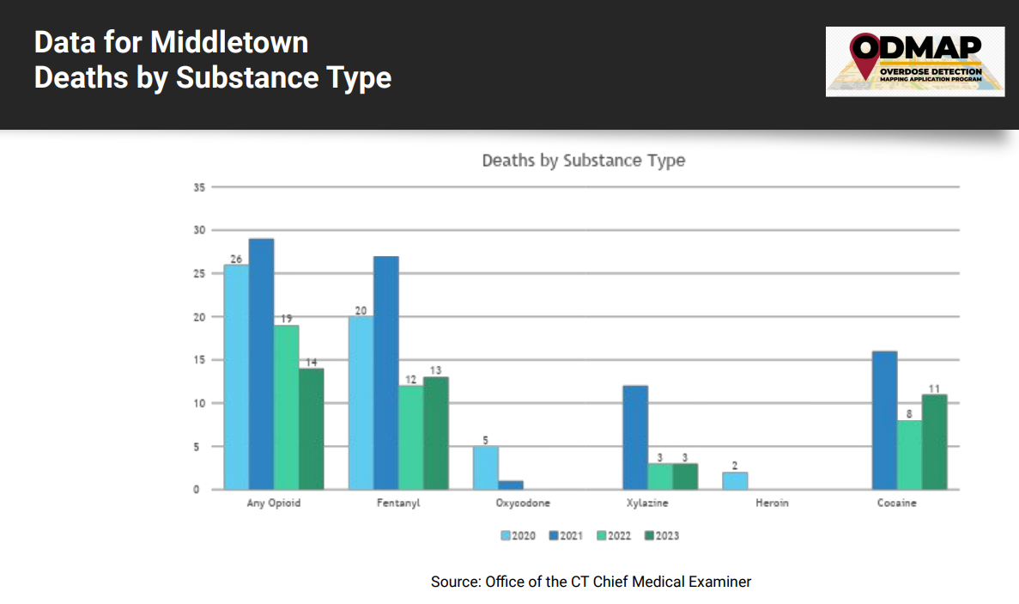

Slide 7
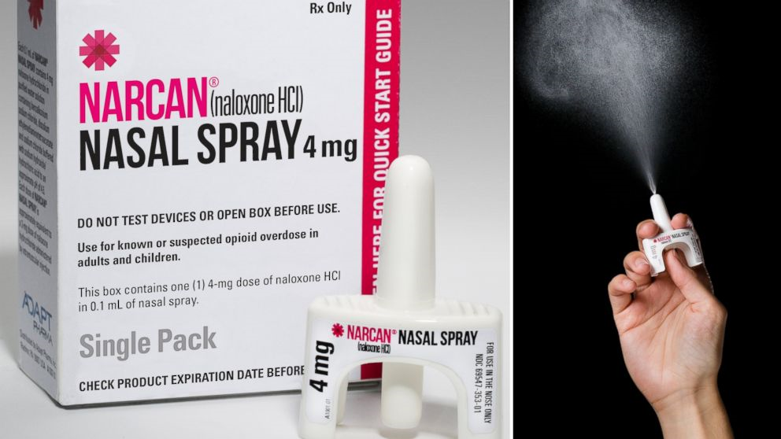
What is Narcan (Naloxone HCI)?
Narcan Nasal Spray is a treatment to reverse the effects of a known or suspected opioid overdose
Is to be given right away
Does not take the place of emergency medical care.
Even if the person wakes up.

Slide 8
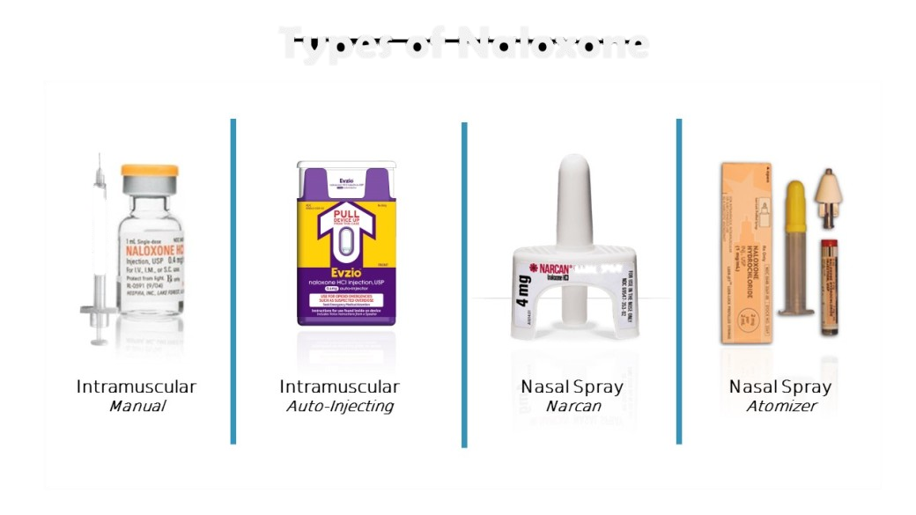
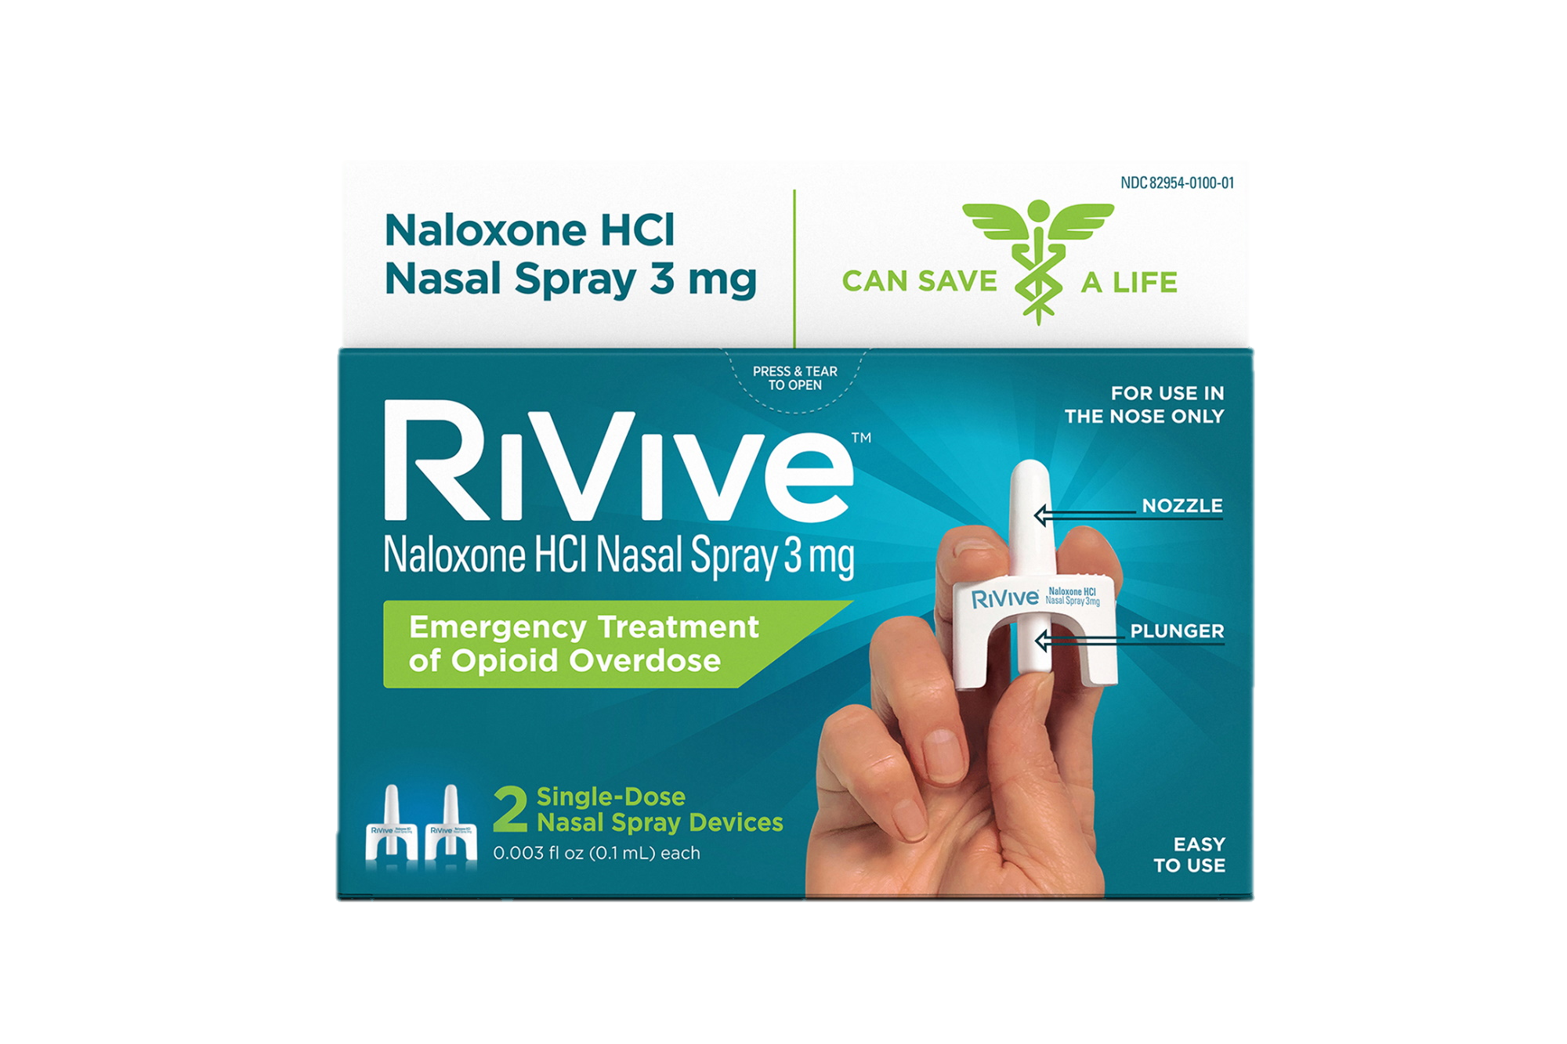
Types of Naloxone
Newly Approved
Center for Key Populations: Reimagining Primary Care

Slide 9
What is the shelf life of Narcan Nasal Spray?
Narcan expiration is 48 months
What are the storage conditions for Narcan Nasal Spray?
Store in moderate temperature (you like to be comfortable, so does your narcan)
Do NOT leave in extreme hot or cold conditions
Examples: cars, fridge, cooler, freezer
Can be stored in everyday bags or drawers in your house, office, building, ect.

Slide 10
What are possible side effects of Narcan Nasal Spray?
Body aches
Diarrhea
Increased heart rate
Fever
Runny nose
Sneezing
Goose bumps
Sweating
Yawning
Nausea or vomiting
Nervousness
Restlessness or irritability
Shivering or trembling
Stomach cramping
Weakness
Increased blood pressure
Notes:
These are also symptoms of opioid withdrawal.

Slide 11
Center for Key Populations: Reimagining Primary Care
Notes:
Veena

Slide 12
Administering Narcan
Notes:
1. Lay the person on their back.
2. Remove Narcan from the box, Peel back the tab with the circle to open the Narcan.
3. Hold the Narcan with your thumb on the bottom of the plunger and your first and middle finger on either side of the nozzle.
4. Tilt the person’s head back and provide support under the neck with your hand.
5. Gently place and insert top of the nozzle into one nostril until your fingers on either side of the nozzle are against the bottom of the person’s nose.
6. Press the plunger firmly to give the dose of Narcan.
7. Remove Narcan from nostril and discard.
8. Move the person to their side immediately and watch them closely.
9. If the person does not respond by waking up or breathing normally Narcan can be administered every 2-3 minutes at a maximum of 3 times.

Slide 13
Administering Narcan
Notes:
NARCAN Nasal Spray- How to use
Stop video at 2:30
https://www.youtube.com/watch?v=WnjgrRNMfKM

Slide 14
Key Information to Review:
Call 911
Stay with someone after giving naloxone.
Narcan can be given again 2-3min after the first one.
Naloxone can reverse an overdose, but can also make someone enter withdrawal.
Withdrawal symptoms can include:
Vomiting
Diarrhea
Sweating
Agitated behavior
Naloxone wears off after 30-45 minutes.

Slide 15
Good Samaritan Law:
Provides protection for those who assist a person who is injured or in danger.
Immunity Laws provide protection from prosecution for calling 911 if seeking medical attention for self or another experiencing an overdose.
You won’t get in trouble for helping!
Center for Key Populations: Reimagining Primary Care

Slide 16
Language Matters
Language is powerful – especially when talking about substance use stigmatizing language perpetuates negative perceptions.
“Person first” language focuses on the person, not the disorder.

Slide 17
When discussing Addictions….
Avoid these terms: | Use these terms instead:
Addict, user, drug abuser, junkie | Person/patient with opioid use disorder or an opioid addiction
Addicted baby | Baby born with neonatal abstinence
Opioid abuse or opioid dependence | Opioid use disorder
Problem | Disease
Habit | Drug addiction
Clean or dirty urine test | Negative or positive urine drug test
Opioid substitution or replacement therapy | Opioid agonist treatment medication for addiction treatment
Relapse | Return to use/setback
Treatment failure | Treatment attempt
Being clean | Being in remission or recovery

Slide 18
Stigma and Addiction
Stigma is a discrimination against an identifiable group of people, a place, or a nation. Stigma about people with SUD might include inaccurate or unfounded thoughts like they are dangerous, incapable of managing treatment, or at fault for their condition.
Notes:
For people with SUD, stigma may stem from antiquated and inaccurate beliefs that addiction is a moral failing, instead of what we know it to be – a chronic, treatable disease from which patients can recover and continue to lead healthy lives.
Can reduce willingness of individuals seeking treatment.
Stigmatizing views of people with SUD are common; this stereotyping can lead others to feel pity, fear, anger, and a desire for social distance from people with SUD.
Stigmatizing language can negatively influence health care provider perceptions of people with SUD, which can impact the care they provide.

Slide 19
How can we change stigmatizing behavior?
“take all steps necessary to reduce the potential for stigma and negative bias”
Learn language to use and avoid.
Use person-first language and let individuals choose how they are described.
Person-first language maintains the integrity of individuals as whole human beings – by removing language that equates people to their condition or has negative connotations.

Slide 20
Recovery Care Coordinators
Every CHC site has a RCC coordinating the program.
RCCs are central to coordinating the patient’s substance use treatment
Bristol, Enfield, New Britain, Groton | Marisa Ortiz ortizmar@chc1.com 959-333-0895
Clinton, Meriden, Waterbury, New London | Carissa Poole poolec@chc1.com 203-499-9690
Danbury, Norwalk, Stamford, Middletown | Lizette Reboira reboirl@chc1.com 860-494-3001
Center for Key Populations: Reimagining Primary Care

Slide 21
Resources for Accessing Narcan
https://harmreduction.org/resource-center/harm-reduction-near-you/
https://nextdistro.org/connecticut

Slide 22
Any Questions?

Slide 23
Thank you! Presentation Made by: Briana Reaves, SUH Program Manager reavesb@chc1.com Presentation Given by: Courtney Morgan, Overdose Prevention Champion- AmeriCorps Member morganc@chc1.com
Center for Key Populations: Reimagining Primary Care
Notes:
If needing Narcan please e-mail us.

